Slide 1
ChatOps: an EPICS adventure
Matt Clarke
Notes:
Slow down!

Slide 2
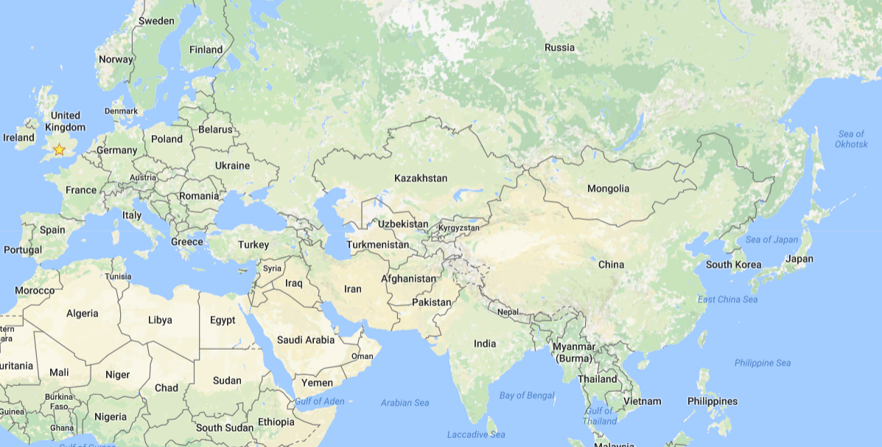
The ISIS neutron and muon facility
Notes:
Slow down!

Slide 3
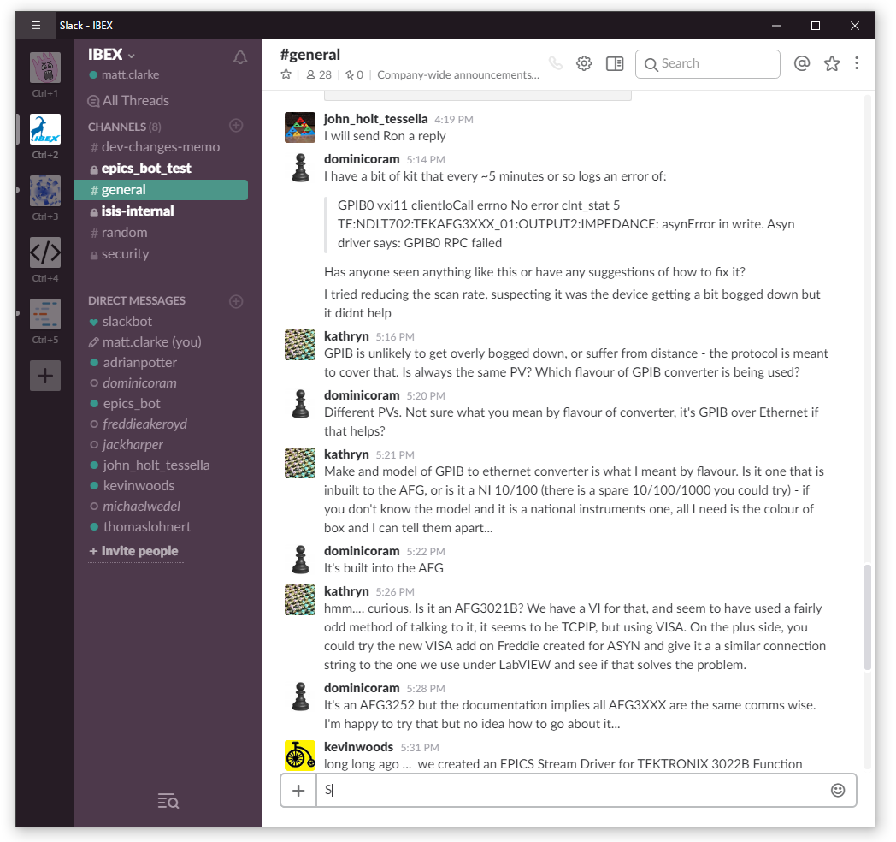
Slack
Alternatives:
Rocket Chat
Ryver
HipChat
AOL IM
…
Notes:
Slow down!

Slide 4
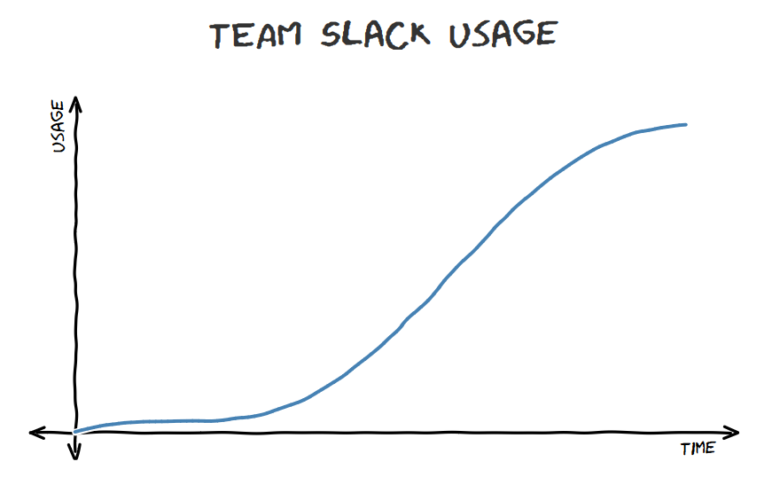
Slack
Notes:
Slow down!

Slide 5
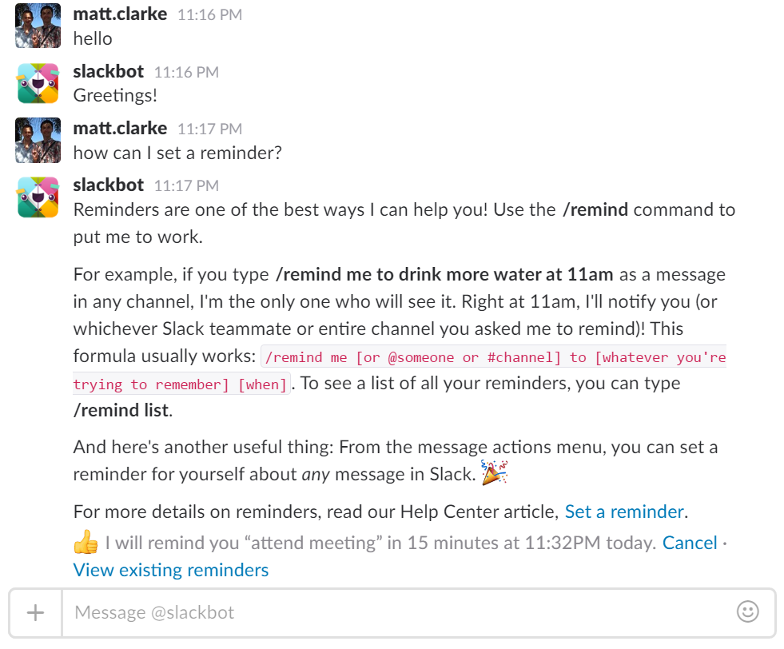
Slackbot
Notes:
Slackbot is an automated member of the team built into slack

Slide 6
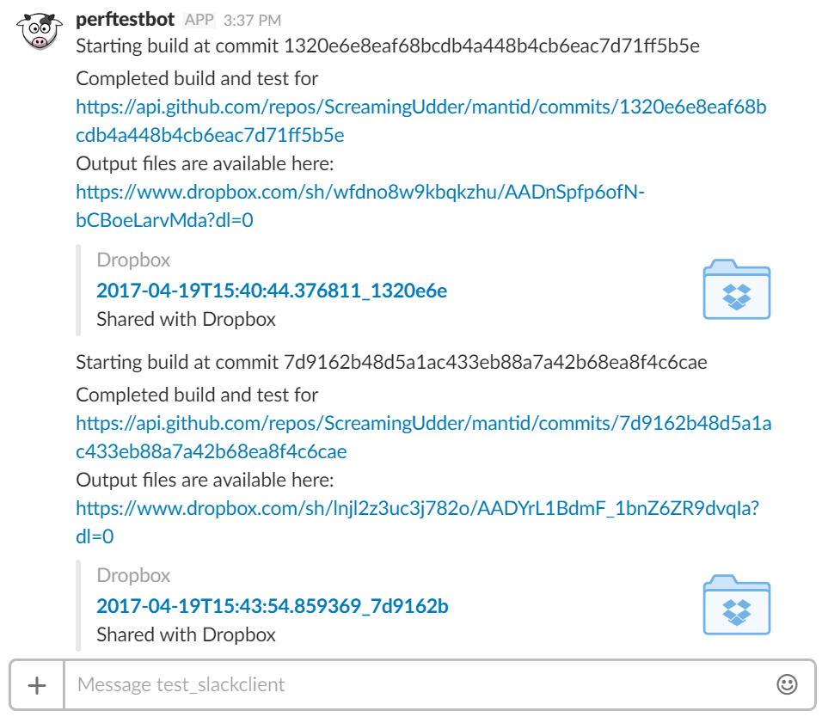
Custom Slackbot
Notes:
Slow down!

Slide 7
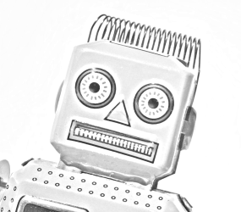
ChatOps
ChatOps [χηατοπσ]
conversation-driven development;
the use of chat clients, chatbots and other communication tools to facilitate software development and operational tasks.
Notes:
Slow down!

Slide 8
Introducing epics_bot
Started off as a weekend project
Needed an idea
How about caget?

Slide 9
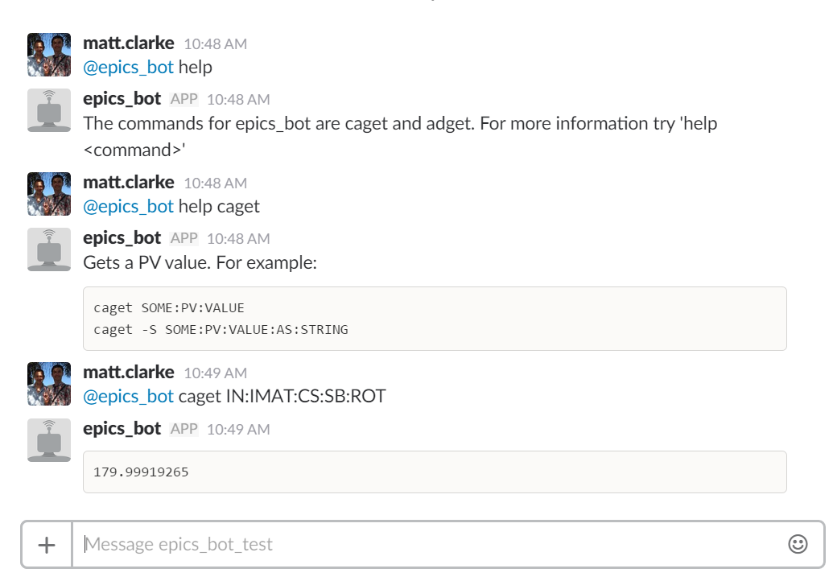
epics_bot: caget
Notes:
Slow down!

Slide 10
epics_bot: waveforms
Truncate long waveforms
Slack character limit of 500
Can convert to char waveforms to string
Notes:
Slow down!

Slide 11
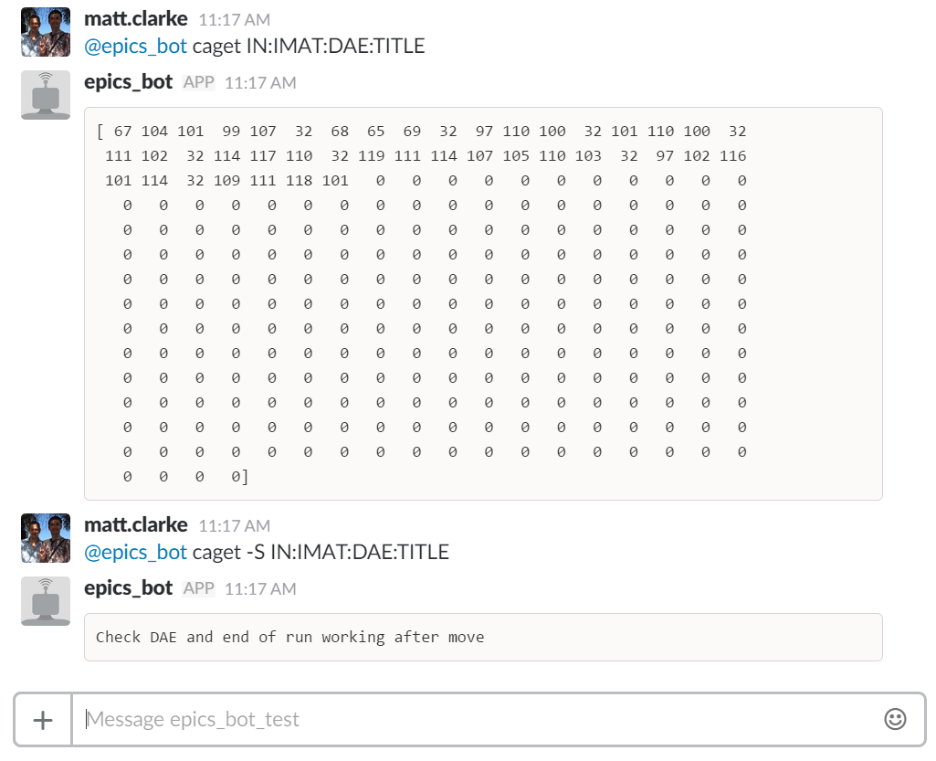
epics_bot: waveforms
Notes:
Slow down!

Slide 12
epics_bot: caget
It works!
Is it useful?
Notes:
Slow down!

Slide 13
epics_bot: adget
Layer 6: EPICS clients
Layer 5: Standard EPICS records
Layer 4: EPICS device support
asyn
Layer 3: Plug-ins
ColorConvert, ROI, StdArrays etc.
Layer 2: Device drivers
Layer 1: Hardware API
Notes:
Slow down!

Slide 14
epics_bot: adget
Layer 6: EPICS clients
Layer 5: Standard EPICS records
Layer 4: EPICS device support
Layer 3: StdArrays
Layer 2: SimDetector
Notes:
Slow down!

Slide 15
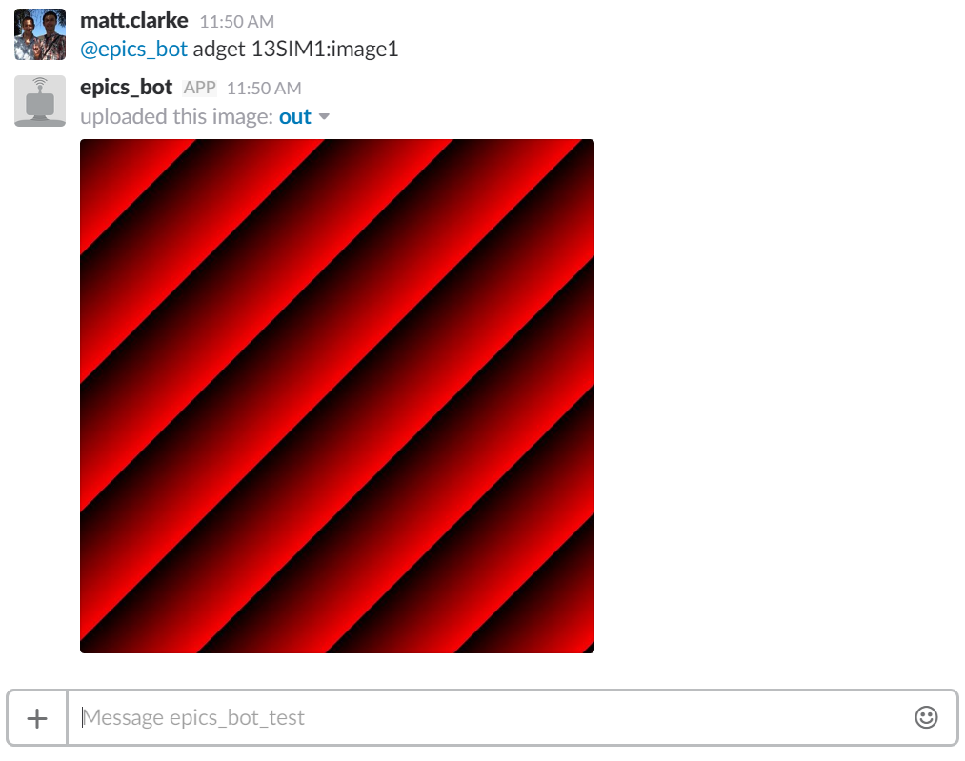
epics_bot: adget
Notes:
Slow down!

Slide 16
epics_bot: adget
Shown to work for smaller images (~10⁶px)
Scales images down to 1024px axis size
Perhaps more efficient to do this on the device side?
JPEG produced with 80% quality
Might even be useful as a tool
Notes:
Slow down!

Slide 17
The code
Python
Uses PyEpics for the EPICS part
SlackClient Python library for the Slack part
PIL for the image generator
Notes:
Slow down!

Slide 18
Summary
Created a Slack bot for talking EPICS
May not be very useful
It is on Github, if you are interested
https://github.com/ISISComputingGroup/epics_bot
Probably won’t receive much future effort
Notes:
Slow down!

Slide 19
Thank you!
https://github.com/ISISComputingGroup/epics_bot
matt.clarke@stfc.ac.uk

