Slide 1

ITER AC/DC Converter Control System
2017. 5. 17
Rahk Sang Lee, Dawonsys
(ryanlee@dawonsys.com)
www.DAWONSYS.COM

Slide 2
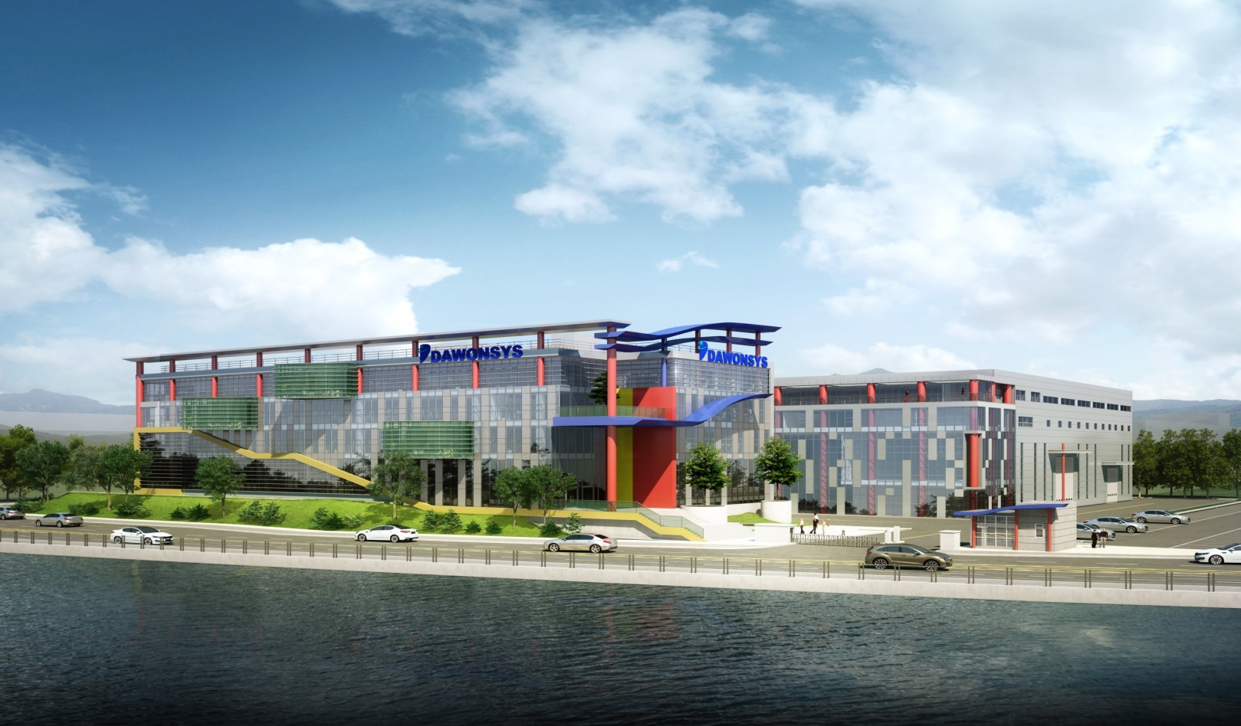
Contents
1. Introduction
2. Control System for CCPS
3. Control System for TFPS

Slide 3
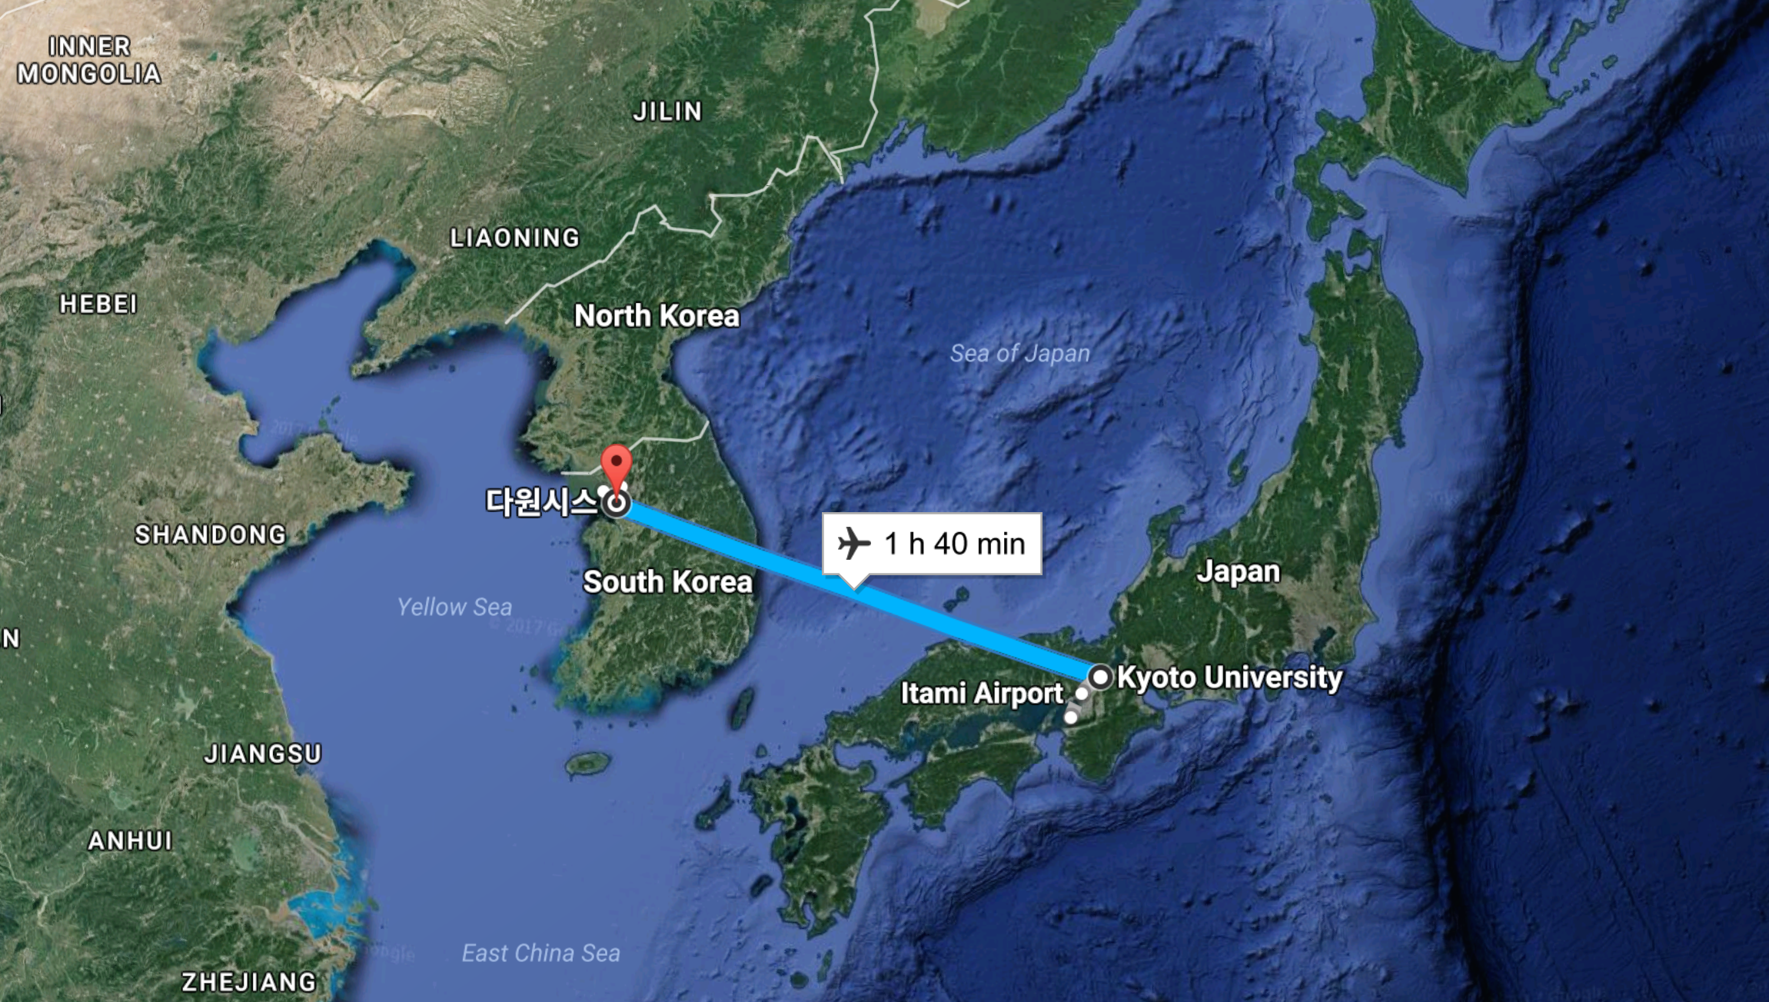
1. Introduction
Location of Dawonsys

Slide 4
1. Introduction
Definition
The scope of this presentation is the I&C design and its implementation such as manufactured controllers, cubicles and verification scenarios for ITER AC/DC converter control system between Master Control System and Coil Power Supply and Distribution
Coil Power Supply and Distribution (CPSD) receives AC power from the GRID and supplies controlled DC power to the TF, PF, CS, CC & VS circuits. It shall also protect the coils by fast discharge of the stored energy in case of quench

Slide 5
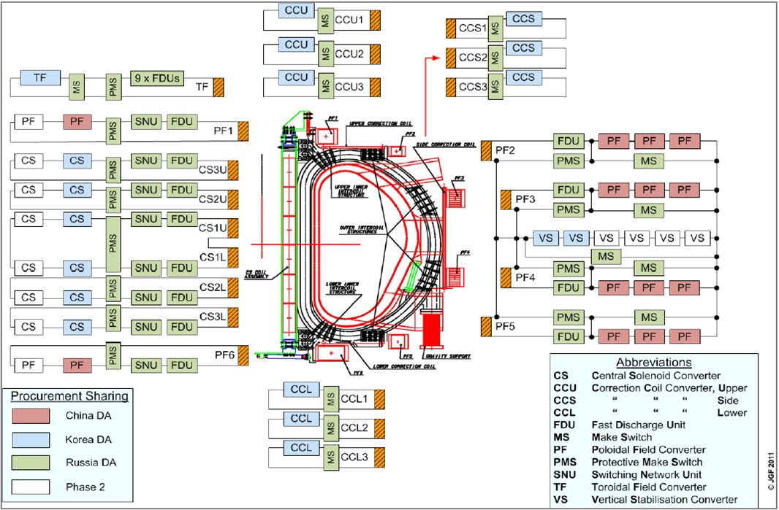
1. Introduction
ITER Power Supply System
CCPS
<Converter Specification>
CS = ±45 kA, ±1050V on-load
PF = ±55 kA, ±1050V on-load
VS = ±22.5 kA, ±1050V on-load
TF = 68 kA, ±650V/ ±160V on-load
CCU/L= ± 10 kA, ± 85V on-load
CCS= ± 10 kA, ± 300V on-load
TFPS
PFCS
<Load>
Dummy Load : 6.73mH/2.2 mΩ
TF : 17.7 H (Coil Inductance)
CS3U : 0.75929 H
CS2U : 0.75929 H
CS2L : 0.75929 H
CS3L : 0.75929 H
CS1 : 1.98136 H
PF1 : 0.70336 H
PF2 : 0.47477 H
PF3 : 1.8555 H
PF4 : 1.5607 H
PF5 : 1.5557 H
PF6 : 2.3901 H
< ITER Coil Power Supply System Configuration >

Slide 6
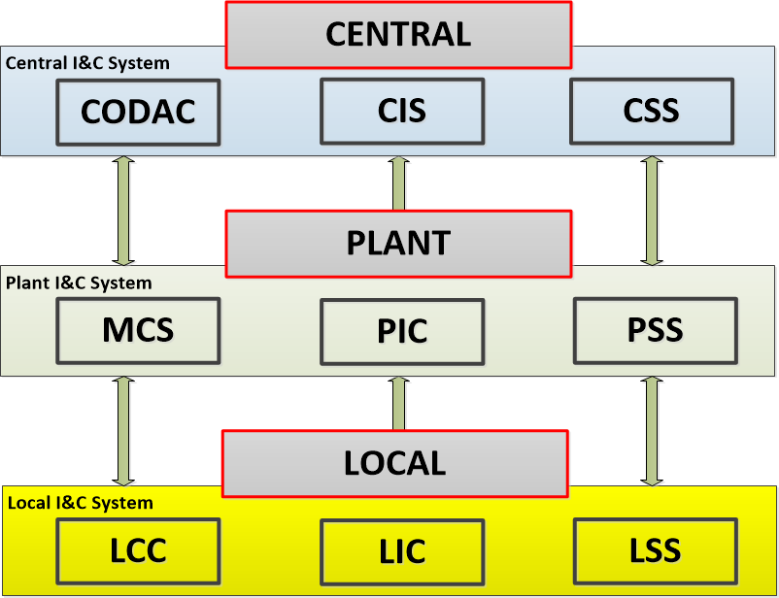
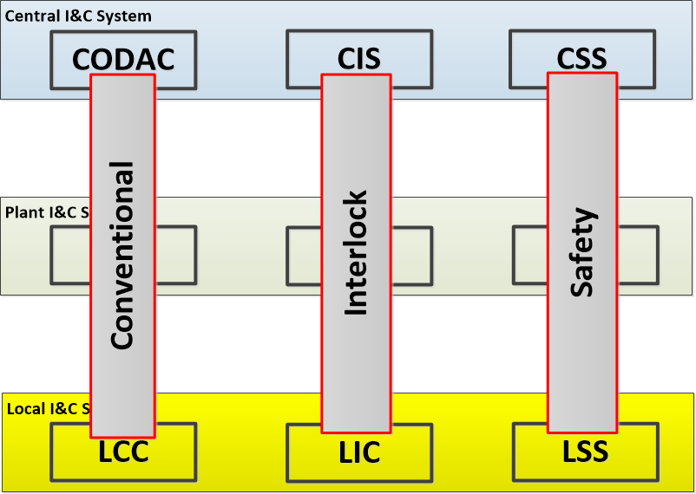
1. Introduction
ITER I&C System
ITER I&C Vertical System is composed with Central, Plant, Local Parts
ITER I&C Horizontal System is composed with conventional, Interlock, Safety Parts
<Vertical>
<Horizontal>

Slide 7
1. Introduction
Master Control System
The CPSS MCS consists of Master Control (MRC), Circuit Control (CCR), Plant Interlock Control (PIC) and Plant Safety Control (PSC)
Master Control (MRC) is to interface with Plasma Control system and CCR through SDN and perform the function of coil power supply operation and integration
Circuit Control (CCR) is to supervise the LCCs for their operation states, monitoring data, etc. and distributes the voltage references from MRC to the corresponding LCCs
Plant Interlock Control is to take in charge of Central Interlock function and interface with Local Interlock Controllers
Plant Safety Control (PSC) is to take the responsibility of the occupational safety for the corresponding plant system and interface with Local Safety Controllers

Slide 8
1. Introduction
Local Control System
AC/DC Converters provide controlled DC current to the ITER magnet system and it is comprised of the line disconnector and earthing devices (AC and DC), converter transformer and phase controlled thyristor converter and sensors
The control system of AC/DC Converter consists of Sequential Controller (SEQC) or Interface Controller (INTFC), which communicates with CCR and plays a role of reference distribution and sequential control, and ALPHA Controller, which controls of thyristor converter, as for conventional control, and Local Interlock Controller (LIC) and Fast LIC (F-LIC) for local interlock control and Local Safety Controller (LSC)

Slide 9
1. Introduction
Control Functions
Master Control System I&C has functional interface with AC/DC Converters for monitoring, control and protection of Coil Power Supply System
Functional interfaces:
  Monitoring and control data
  Dispatching voltage reference
  Converter status information forward
  Coordination of CVOS
  TF converter operation (only for TFPS MCS)
  To connect to other plant systems for monitoring and control
  Perform fast discharge interlock function
  Perform bypass loop interlock function
  Integrated interlock function of Coil Power Supply System
  Investment protection for the AC/DC Converter
  Perform central occupational safety function
  Occupational safety protection of the AC/DC Converter

Slide 10
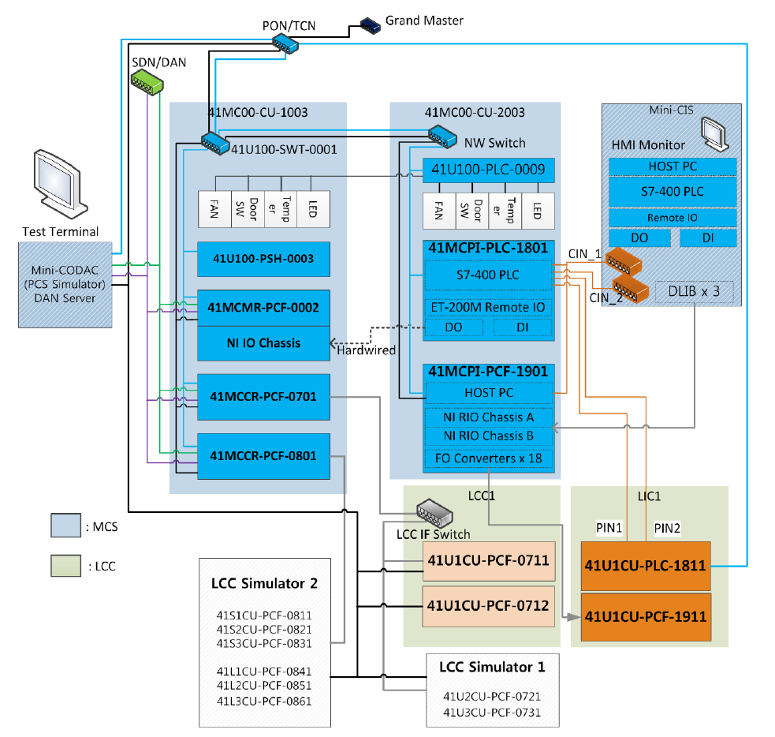
2. Control System for CCPS
FAT Configuration
※ FAT : Factory Acceptance Test
< Configuration of CCPS FAT >

Slide 11
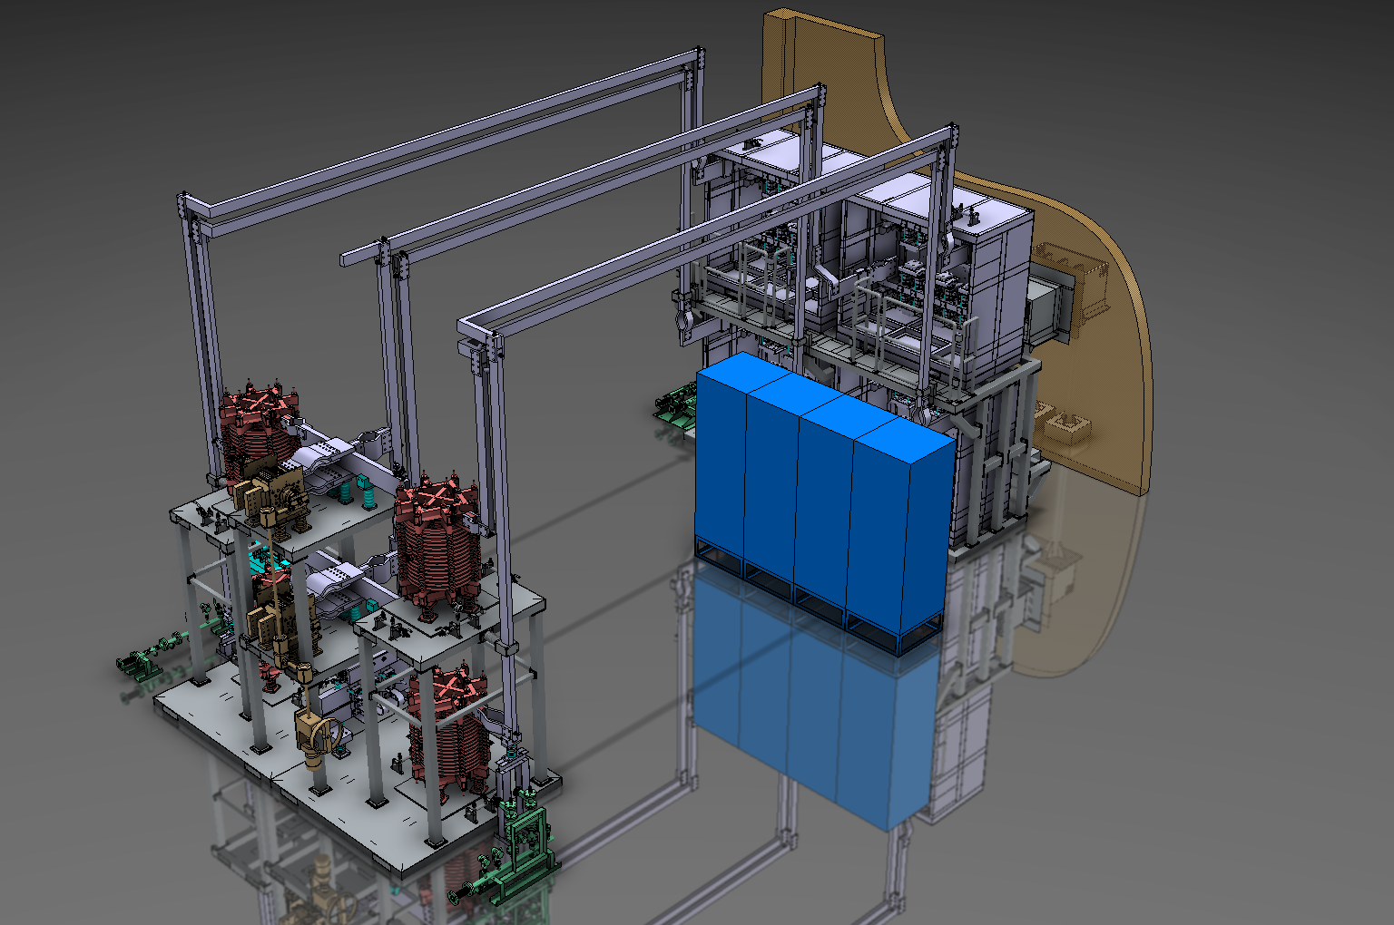
2. Control System for CCPS
Layout of CCU/L Converter
DC Interconnecting
Busbar
AC busbar
Converter
Bridge
Fire wall
DCDS
DC Inductor
DCES
Control
Cubicle
Bypass
Switch
CCWS
Manifold
< Configuration of CCPS FAT in Local Side>

Slide 12
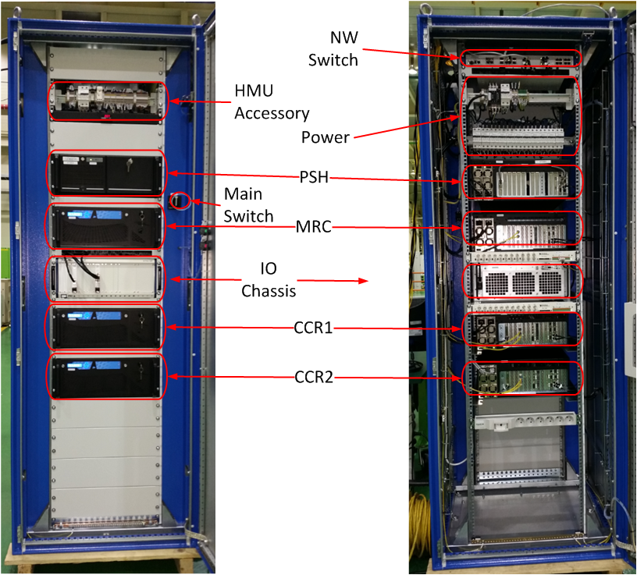
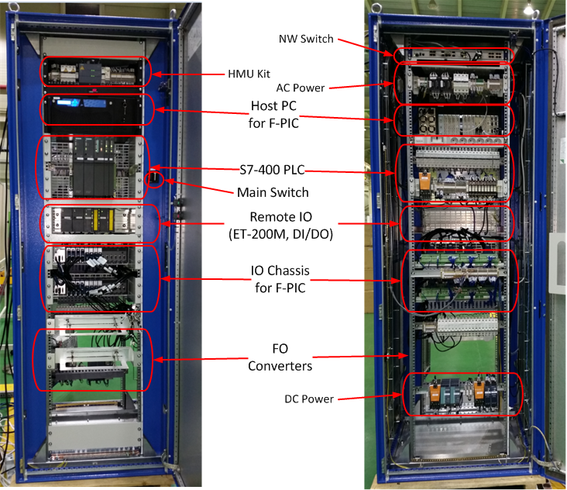
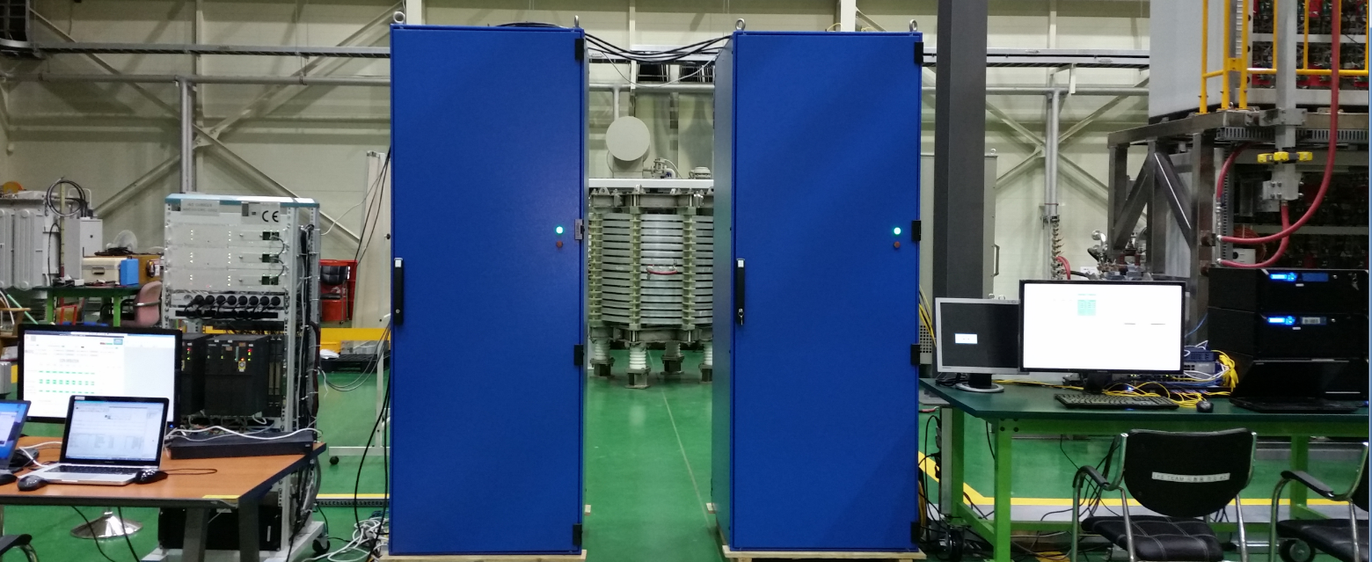
2. Control System for CCPS
Manufactured System
Manufactured Master Control System for FAT
Industrial PC x 1
S7-400 PLC x 2
ET-200M Remote IO x 2
DLIB x 3
<Front & Rear View of Interlock Cubicle>
<Front & Rear View of Conventional Cubicle>
mini-CIS
Interlock Cubicle
(41MC00-CU-2003)
Conventional Cubicle
(41MC00-CU-1003)
Test Terminal
(mini-CODAC)
LCC Simulator

Slide 13
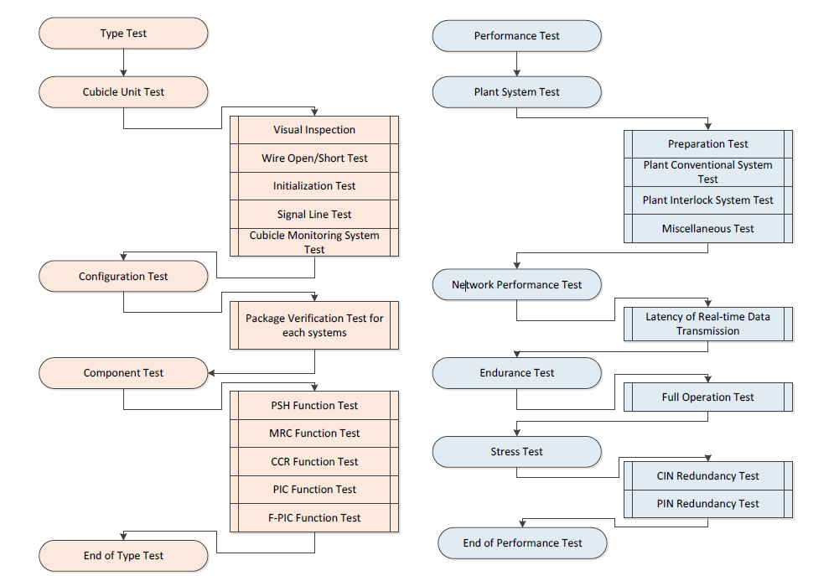
2. Control System for CCPS
Type Test Procedure
  To verify the hardware and mechanical parts of MCS cubicle are well assembled and operate properly and functions of each components are well implemented according to their requirements
  Cubicle Unit Test
    The appearances with no damage and the wiring
    Wires are well-connected with each other and well opened with neighbor wires and earth
    Normal condition after initialization and ready for operation
    Digital in/output signal could be read/set properly
  Configuration Test
    To verify that the installed firmware/software package and configuration parameters are valid
  Component Test
    PSH functions: plant system PVs, SYSMON PVs, HMU PVs
    MRC functions: MRC PVs, voltage control, current control with no coupling, real-time transmission, transmission of converter status information, co-ordination of current return to zero, data archiving
    CCR functions: CCR PVs, monitoring and control data, dispatching voltage reference, converter status information forward, transient recorder management, co-ordination of converter operational states
    PIC functions: PIC PVs, F-PIC PVs, hardwired signals, network redundancy

Slide 14
2. Control System for CCPS
Performance Test Procedure
  Conceivable test cases in the environment of all the relevant components installed and running without a problem
  Plant System Test
    Conventional : State machine, voltage control, current loop control with no coupling, coordination of current return to Zero,
    Interlock: : Power permit, Converter Fault, Fast discharge, Usage for CPU and Memory , Alarm Test, Archive Test, Log Test.
  Network Performance Test
    The transmission delay within the MCS system and/or caused by the converters and its local controllers.
  Endurance Test
    To check that the MCS operates properly over a long period of time.
    The full plasma operation scenario is performed repeatedly. If some errors occurred, then the operation scenario will be stopped immediately and reported error cause.
  Stress Test
    To check interlock actions is occurred, one of PIN/CIN network is disconnected.

Slide 15
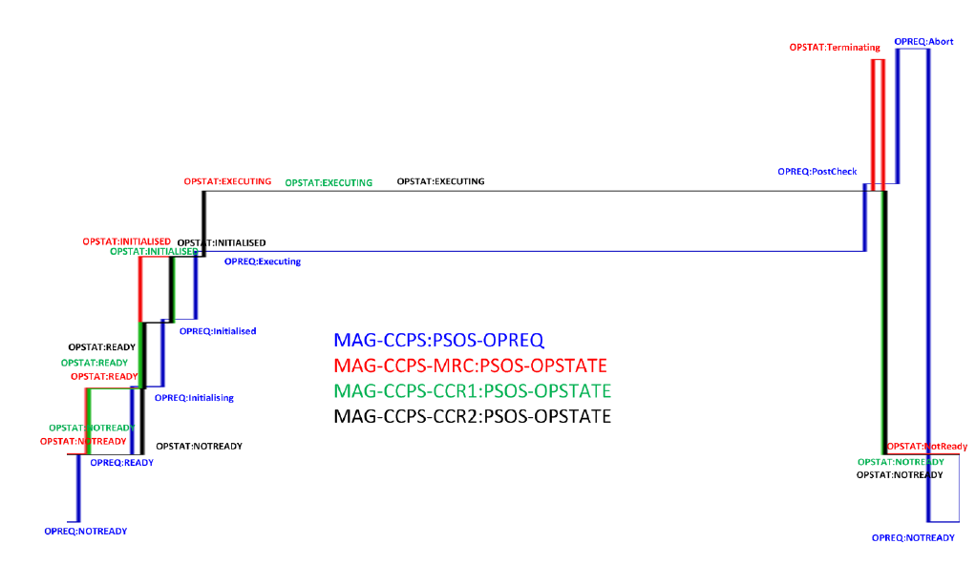
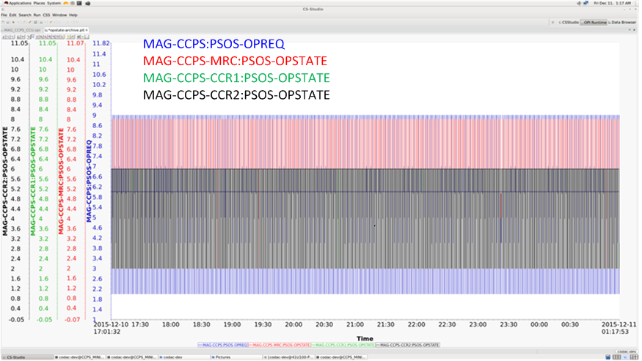
2. Control System for CCPS
HMI – Data Browser
< Cycle of the operation Scenario >
  Any PV registered with archiving property can be investigated using the data browser.
  This screen shows the archived values for PSOS OPREQ and PSOS OPSTATE.
  The figure on the right shows the magnified view for one cycle.

Slide 16
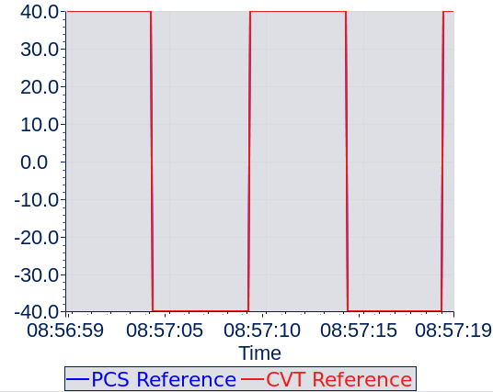
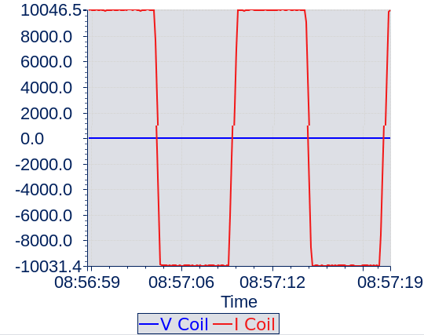
2. Control System for CCPS
Voltage Control
< Voltage reference from PCS simulator >
< Voltage/current value from converter >
  - PCS Reference : Voltage reference received from the PCS
  - CVT Reference : Voltage reference transmitted to the converter
  - V Coil : Coil voltage value read from the converter
  - I Coil : Coil current value read from the converter
  The voltage reference is sent from PCS over SDN, and retrieved by MRC and then sent to subordinate CCR over SDN, The CCRs send this value to subordinate LCC over local Ethernet interface (1KHz)
  Voltage reference from the PCS simulator together with the converted reference by MRC
  Coil Voltage and coil current which are read from the converter.
    The coil current follows the shape of the voltage reference from the PCS simulator, between -10kA and 10kA.

Slide 17
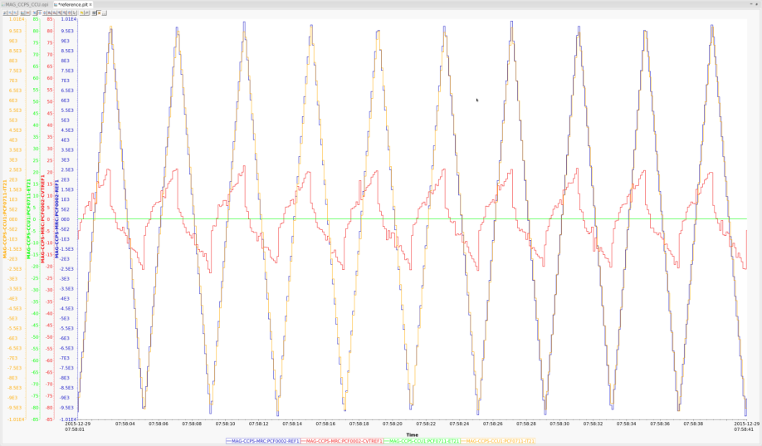
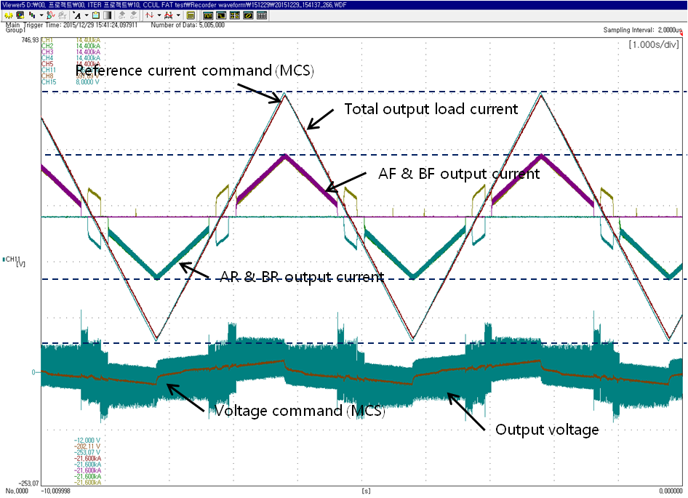
2. Control System for CCPS
Current Loop Control
< Data browser screen of the archived data >
< oscilloscope image captured at the converter side >
  This test verifies composite functions by checking PVs for voltage reference and current values at the LCC (1KHz)
  The current reference from the PCS simulator, converted voltage reference from MRC, coil current value from the converter
  The magnified view at the converter side captured using an oscilloscope

Slide 18

2. Control System for CCPS
FAT Sketch
Duration: 9th ~ 11th Dec. 2015
Location: Dawonsys factory (Ansan)

Slide 19
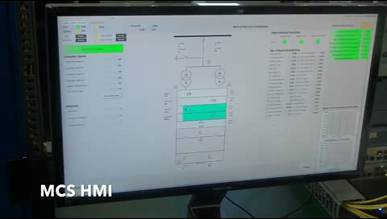
2. Control System for CCPS
HMI – Converter Operation
Duration: 9th ~ 11th Dec. 2015
Location: Dawonsys factory (Ansan)
COS/PSOS State
Converter Status
Critical Interlock Status
Alarm Status
Additional Status
Non-critical Interlock Status
Operation Commands
Navigation Bar

Slide 20
3. Control System for TFPS
FAT Configuration
< Configuration of TFPS FAT >

Slide 21
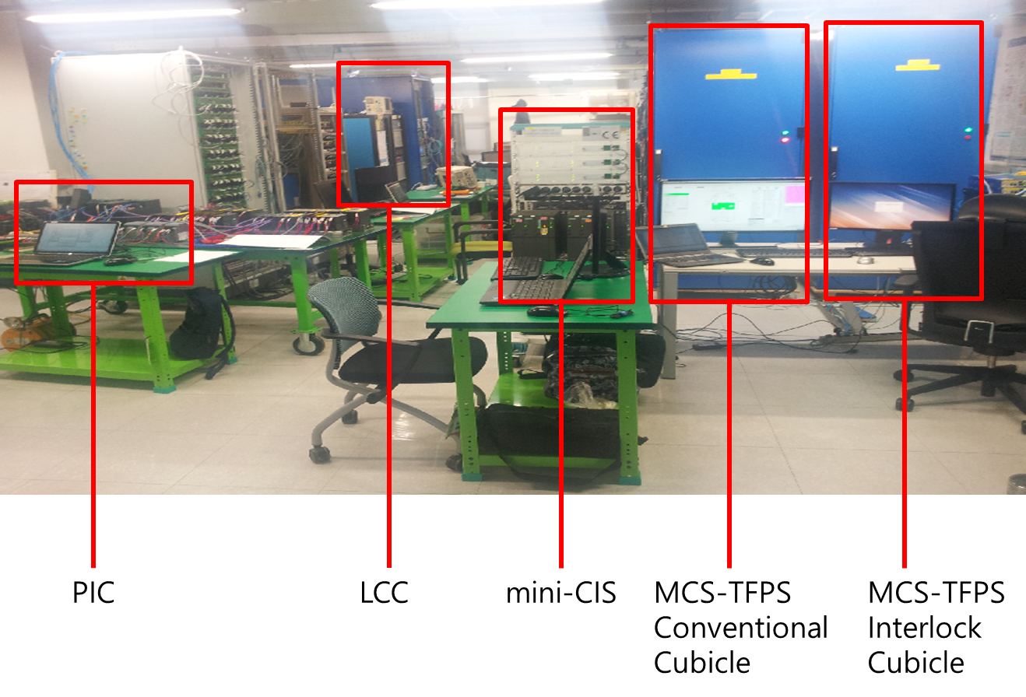
3. Control System for TFPS
Manufactured System
Manufactured Master Control System for FAT

Slide 22
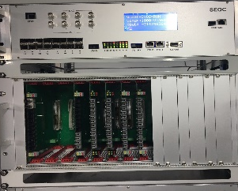
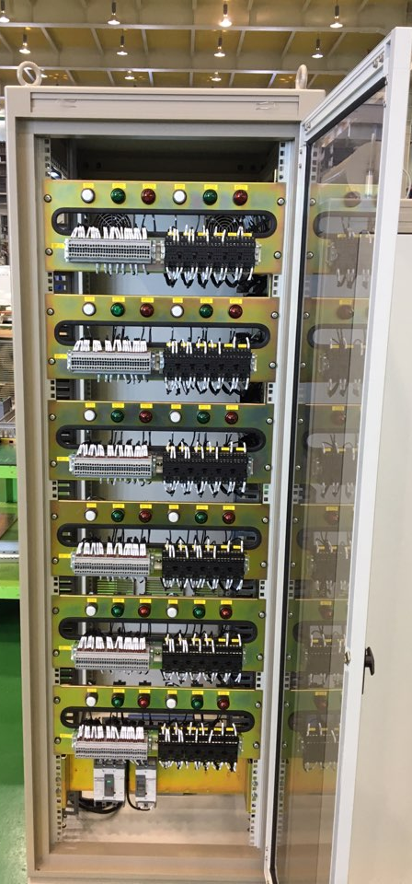
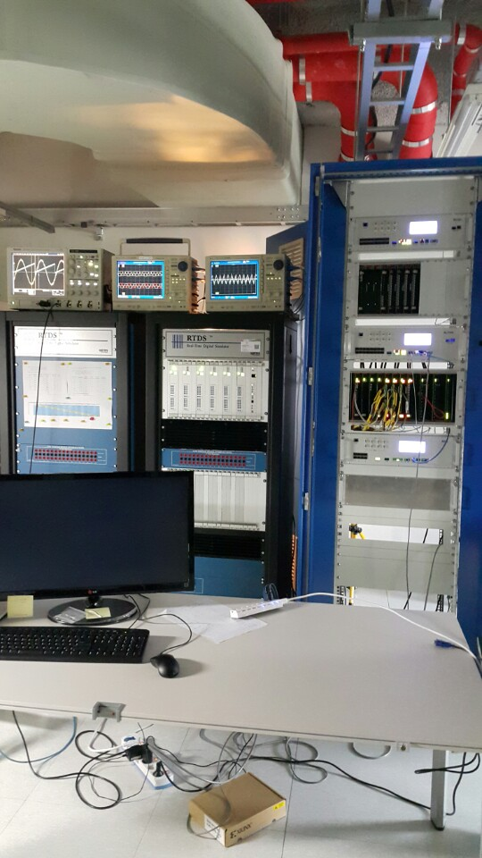
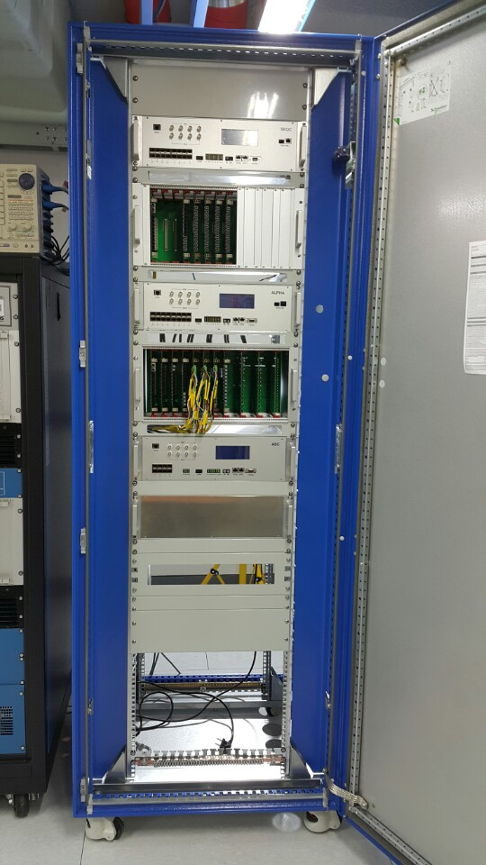
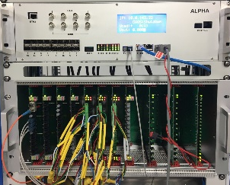
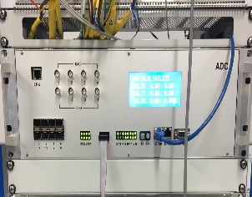
3. Control System for TFPS
※ RTDS : real time power system simulator
제어기 기술 확립
Manufactured System
Manufactured Local Control System and RTDS
Sequential Controller
Xilinx ZYNQ (7045)
Linux
Alpha Controller
Xilinx ZYNQ (7045)
RTOS
Relay IN : 27 ch
Relay OUT : 14 ch
Fiber IN : 44 ch
Fiber OUT : 52 ch
Analog to Digital Converting Controller
- 18 bit ADC
- 18 Channel
<Conventional Cubicle>
<LCC Simulator>
<RTDS System>

Slide 23
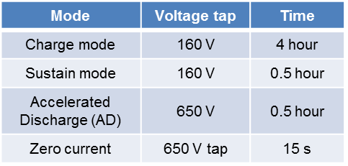
3. Control System for TFPS
※ RTDS : real time power system simulator
제어기 기술 확립
Test Scenario
TFPS Test Scenario for Integrated Test (MCS, LCC and RTDS)
  Execute the sustain mode during charge mode
  Execute the accelerated discharge during normal operation
Icoil
Charge
mode
Sustain
mode
Discharge
mode
Zero
current
TF coil current (commend)
Bypass switch current
Accelerated discharge
Tap change
(650V tap)
68 kA
55 kA
35 kA
15 kA
0.45h
0.35h
1.2h
0.2h
0.6h
0.2h
1h
4hour
T1
0.5hour
T2
0.5hour
15s
T4
T3
Accelerated discharge command (MCS → LCC)

Slide 24
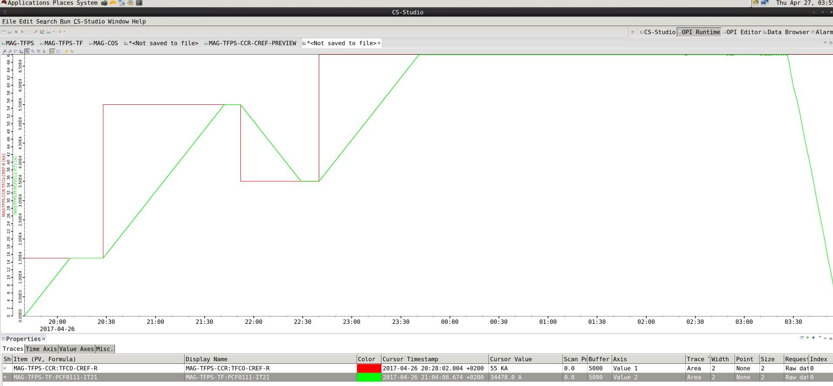
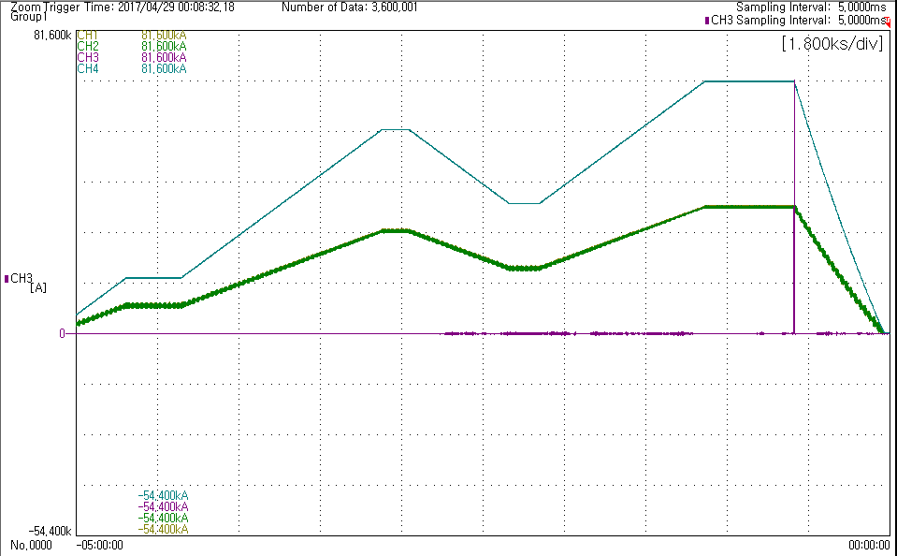
3. Control System for TFPS
제어기 기술 확립
Integrated Test
Duration: 25th ~ 28th Apr. 2017
Location: National Fusion Research Institute (NFRI) (Daejeon)
1 KHz Operation
Accelerated Discharge
Coil Current
Coil Current
Reference from Upper System
Accelerated Discharge
Bridge Current
Bypass Current
< Master Control System HMI >
< Raw Data from Converter captured by Oscilloscope >

Slide 25
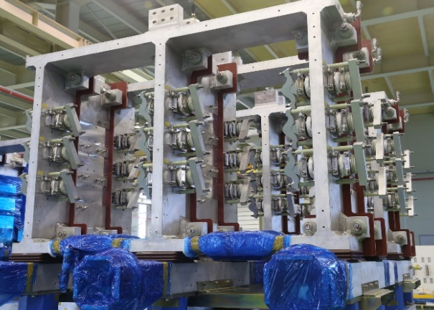
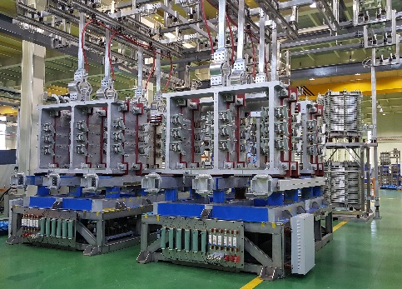
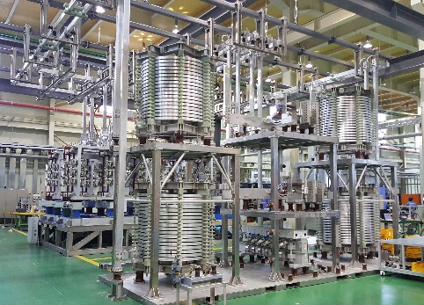
Appendix
Manufactured VS-1 Converter
Manufactured VS1-1 Converter in Dawonsys Factory
<VS1 Converter in Factory>

